Slide 1
TIC TAC TOE GAME
[ 1 ] Start
[ 2 ] Help
[ 3 ] Color Theme
[ 4 ] Credit
[ 5 ] Highscore
[ 6 ] Exit

Slide 2
HIGHSCORE
Nama
Grid
LevelComputer
Time

Slide 3
MENU HELP

Slide 4
CREDIT
Game’s name :
Developer 1 :
Developer 2 :
Comment :
Thanks! Hope you guys can enjoy this game

Slide 5
HOW TO PLAY

Slide 6
NAME PLAYER
Input Player1’s name :
Azhar
Azhar’s symbol is ‘X’
Input Player2’s name :
Difa
Difa’s symbol is ‘O’

Slide 7
LEVEL BOT
[ 1 ] Easy
[ 2 ] Normal
[ 3 ] Hard

Slide 8
OPPONENT
[ 1 ] Player2
[ 2 ] Bot

Slide 9
GRID SIZE
[ 1 ] 3x3
[ 2 ] 5x5
[ 3 ] 7x7

Slide 10
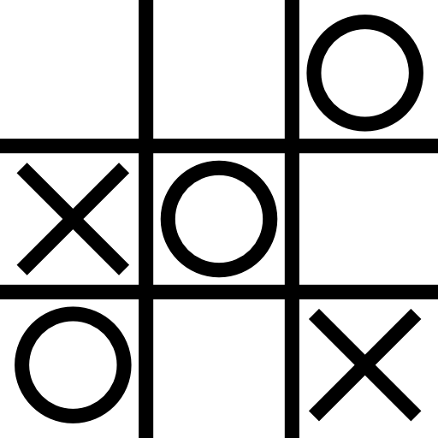
BOARD GAME 3X3

Slide 11
GAMEPLAY
Azhar’s turn

Slide 12
RESULT
Difa wins

Slide 13
White
Purple
01
01
Blue
Aqua
02
02
Gray
Red
03
03
Pink
Light Blue
04
04
COLOR THEME
Text Color
Background Color

